Slide 1
Route Optimization
Based On Crowd Sourced Data
Collaboration and Class Diagram
Group Members:
1405009
1405013
1405014
1405015
1405016

Slide 2
We divided our whole system into 3 subsystems:
Registration/LogIn Subsystem
Traffic Update Subsystem
Route Proposal Subsystem

Slide 3
Registration/LogIn Subsystem
Use Case | Actor(s)
Register | User, Media
Log In | User, Media
Log Out | User, Media
Restore Password | User, Media

Slide 4
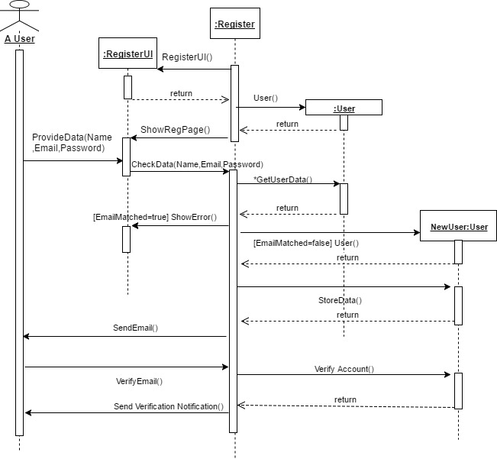
Register : Sequence Diagram

Slide 5
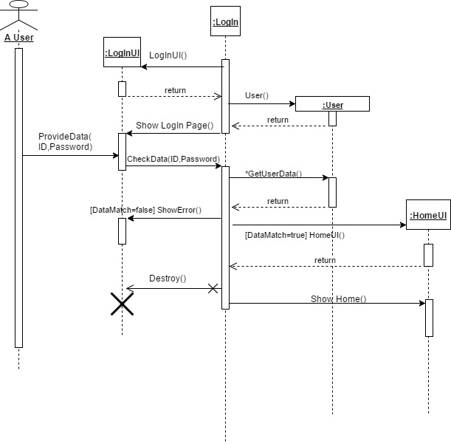
LogIn : Sequence Diagram

Slide 6
2. Traffic Update Subsystem
Use-Case | Actor(s)
Update | User, Media, Admin
Undo | User, Media, Admin

Slide 7
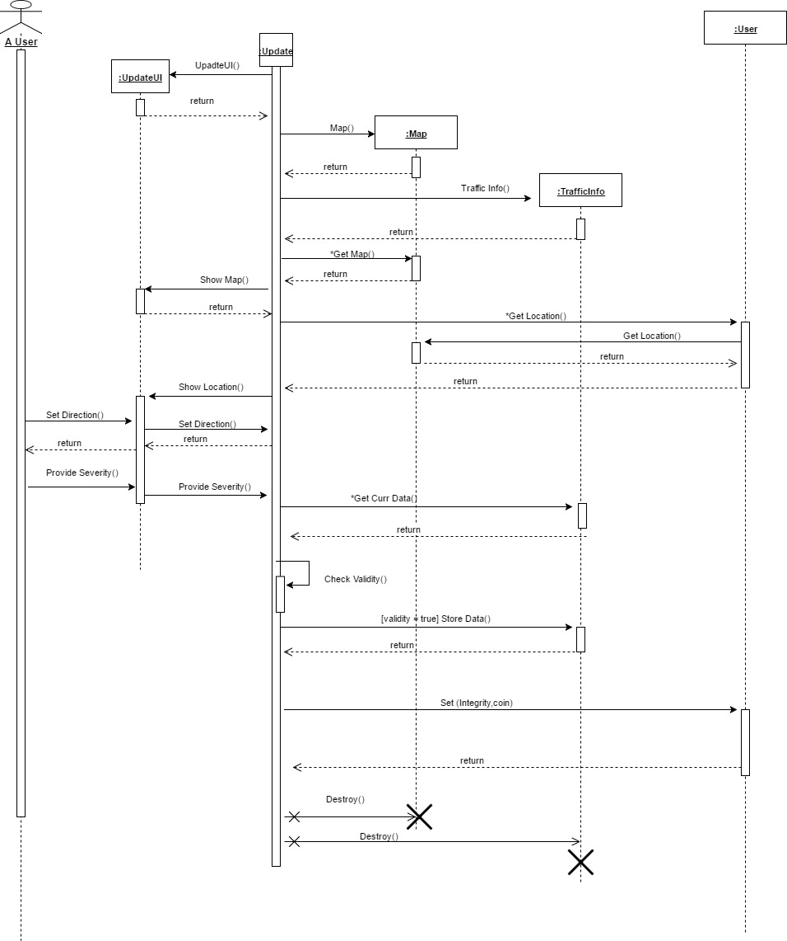
Update : Sequence Diagram

Slide 8
Update: Sequence Diagram
:UpdateUI
:Update
:Map
:Traffic Info
:User

Slide 9
3. Route Proposal Subsystem
Use-Case | Actor(s)
Get Direction | User
Show Current Situation | User

Slide 10
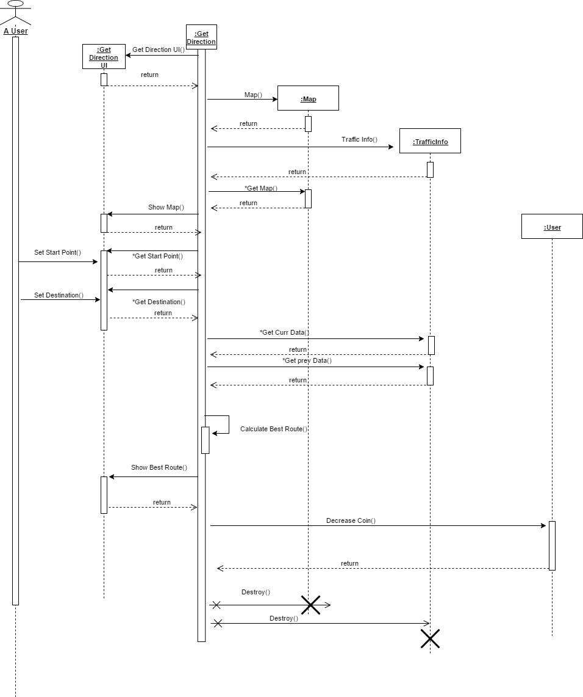
Get Direction: Sequence Diagram

Slide 11
Get Direction: Sequence Diagram
:Get Direction
UI
:Get
Direction
:Map
:Traffic Info
:User

Slide 12
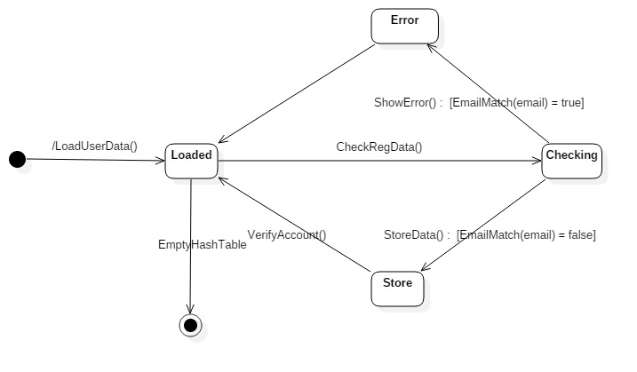
State Chart for User Class

Slide 13
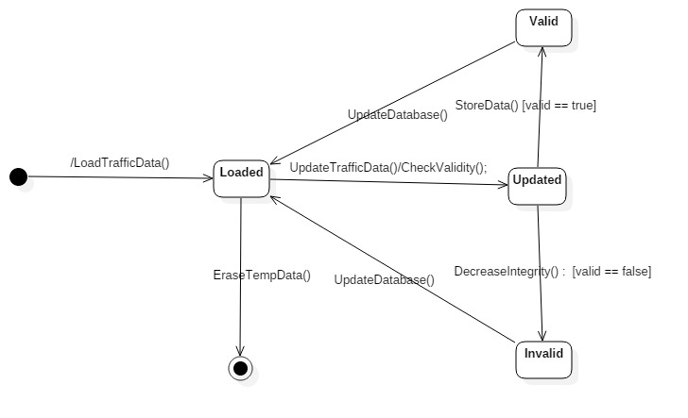
State Chart for TrafficInfo Class

Slide 14
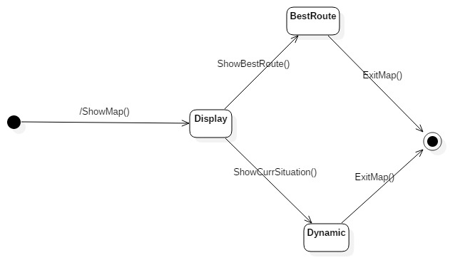
State Chart for Map Class

Slide 15
Thank You

